Slide 1
Chapter - 1 What is “GIT”
Version Control and Git Basics

Slide 2
Version control : What is it ?
A version control system (also known as a Revision Control System) is a repository of files, often the files for the source code of computer programs, with monitored access. Every change made to the source is tracked, along with who made the change, why they made it, and references to problems fixed, or enhancements introduced, by the change.
The Repository
At the core of the version control system is a repository, which is the central store of that system's data. The repository usually stores information in the form of a filesystem tree—a hierarchy of files and directories. Any number of clients connect to the repository, and then read or write to these files. By writing data, a client makes the information available to others; by reading data, the client receives information from others

Slide 3
The Working Copy
A version control system's value comes from the fact that it tracks versions of files and directories, but the rest of the software universe doesn't operate on “versions of files and directories”. Most software programs understand how to operate only on a single version of a specific type of file. So how does a version control user interact with an abstract—and, often, remote—repository full of multiple versions of various files in a concrete fashion? How does his or her word processing software, presentation software, source code editor, web design software, or some other program—all of which trade in the currency of simple data files—get access to such files? The answer is found in the version control construct known as a working copy.
A working copy is, quite literally, a local copy of a particular version of a user's VCS-managed data upon which that user is free to work. Working copies appear to other software just as any other local directory full of files, so those programs don't have to be “version-control-aware” in order to read from and write to that data. The task of managing the working copy and communicating changes made to its contents to and from the repository falls squarely to the version control system's client software.

Slide 4
Version Control Vocabulary (Key terms)
commit
To make a change to the project; more formally, to store a change in the version control database in such a way that it can be incorporated into future releases of the project. "Commit" can be used as a verb or a noun.
log message
A bit of commentary attached to each commit, describing the nature and purpose of the commit. Log messages are among the most important documents in any project: they are the bridge between the highly technical language of individual code changes and the more user-oriented language of features, bugfixes, and project progress.

Slide 5
Update
To ask that others' changes (commits) be incorporated into your local copy of the project; that is, to bring your copy "up-to-date". This is a very common operation; most developers update their code several times a day, so that they know they're running roughly the same thing the other developers are running, and so that if they see a bug, they can be pretty sure it hasn't been fixed already.
Repository
A database in which changes are stored. Some version control systems are centralized: there is a single, master repository, which stores all changes to the project. Others are decentralized: each developer has his own repository, and changes can be swapped back and forth between repositories arbitrarily. The version control system keeps track of dependencies between changes, and when it's time to make a release, a particular set of changes is approved for that release. The question of whether centralized or decentralized is better is one of the enduring holy wars of software development; try not to fall into the trap of arguing about it on your project lists.
Checkout
The process of obtaining a copy of the project from a repository. A checkout usually produces a directory tree called a "working copy" (see below), from which changes may be committed back to the original repository. In some decentralized version control systems, each working copy is itself a repository, and changes can be pushed out to (or pulled into) any repository that's willing to accept them.

Slide 6
Working copy
A developer's private directory tree containing the project's source code files, and possibly its web pages or other documents. A working copy also contains a little bit of metadata managed by the version control system, telling the working copy what repository it comes from, what "revisions" (see below) of the files are present, etc.
Revision, change, changeset
A "revision" is usually one specific incarnation of a particular file or directory. For example, if the project starts out with revision 6 of file F, and then someone commits a change to F, this produces revision 7 of F. Some systems also use "revision", "change", or "changeset" to refer to a set of changes committed together as one conceptual unit.
These terms occasionally have distinct technical meanings in different version control systems, but the general idea is always the same: they give a way to speak precisely about exact points in time in the history of a file or a set of files (say, immediately before and after a bug is fixed).
Diff
A textual representation of a change. A diff shows which lines were changed and how, plus a few lines of surrounding context on either side. A developer who is already familiar with some code can usually read a diff against that code and understand what the change did, and even spot bugs.

Slide 7
Tag
A label for a particular collection of files at specified revisions. Tags are usually used to preserve interesting snapshots of the project. For example, a tag is usually made for each public release, so that one can obtain, directly from the version control system, the exact set of files/revisions comprising that release.
Branch
A copy of the project, under version control but isolated, so that changes made to the branch don't affect the rest of the project, and vice versa, except when changes are deliberately "merged" from one side to the other (see below). Branches are also known as "lines of development". Even when a project has no explicit branches, development is still considered to be happening on the "main branch", also known as the "main line" or "trunk".
Merge (a.k.a. port)
To move a change from one branch to another. This includes merging from the main trunk to some other branch, or vice versa. In fact, those are the most common kinds of merges.
"Merge" has a second, related meaning: it is what the version control system does when it sees that two people have changed the same file but in non-overlapping ways. Since the two changes do not interfere with each other, when one of the people updates their copy of the file (already containing their own changes), the other person's changes will be automatically merged in. This is very common, especially on projects where multiple people are hacking on the same code.

Slide 8
Conflict
What happens when two people try to make different changes to the same place in the code. All version control systems automatically detect conflicts, and notify at least one of the humans involved that their changes conflict with someone else's. It is then up to that human to resolve the conflict, and to communicate that resolution to the version control system.
Lock
A way to declare an exclusive intent to change a particular file or directory. For example, "I can't commit any changes to the web pages right now. It seems Alfred has them all locked while he fixes their background images." Not all version control systems even offer the ability to lock, and of those that do, not all require the locking feature to be used. This is because parallel, simultaneous development is the norm, and locking people out of files is (usually) contrary to this ideal.

Slide 9
GIT – BASICS
Understanding git (version control system)

Slide 10
GIT in a nutshell
The whole idea of GIT is to take a snapshot of your project at different time intervals so that if anything wrong happens, one can restore the project’s state at a particular time in the past.
Git is also useful in situations when there are two people editing the same file. They may pull the same file, edit it, commit changes and then push it to remote server. Now, If they are using FTP then it is possible that they may overwrite each other changes. But if they are using Git then it will try to merge these changes.

Slide 11
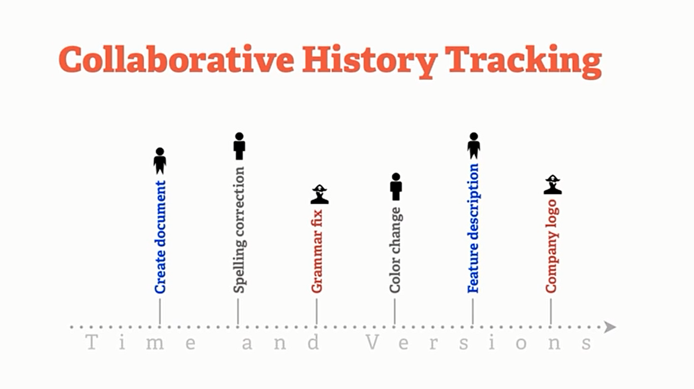
Version Control
Simple chart showing of what it does. GIT not only tracks simple history but it also tracks,
What is changed.
who changed it.
Why the changed it.
When they changed it.

Slide 12
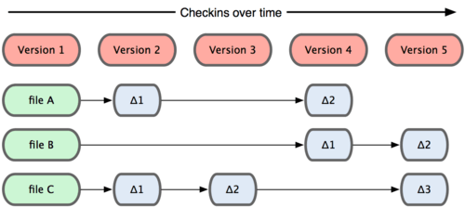
GIT takes snapshots
The major difference between Git and any other VCS (Subversion and friends included) is the way Git thinks about its data. Conceptually, most other systems store information as a list of file-based changes. These systems (CVS, Subversion, Perforce, Bazaar, and so on) think of the information they keep as a set of files and the changes made to each file over time, as illustrated in Figure.

Slide 13
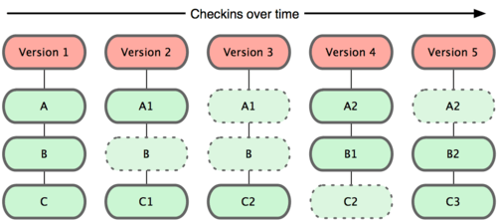
Every time you commit, or save the state of your project in Git, it basically takes a picture of what all your files look like at that moment and stores a reference to that snapshot. To be efficient, if files have not changed, Git doesn’t store the file again—just a link to the previous identical file it has already stored.

Slide 14
Some main points about GIT
Nearly Every Operation Is Local : Most operations in Git only need local files and resources to operate — generally no information is needed from another computer on your network. This aspect makes GIT very speedy, Because you have the entire history of the project right there on your local disk, most operations seem almost instantaneous
Git Has Integrity : Everything in Git is check-summed before it is stored and is then referred to by that checksum. This means it’s impossible to change the contents of any file or directory without Git knowing about it. This functionality is built into Git at the lowest levels and is integral to its philosophy. You can’t lose information in transit or get file corruption without Git being able to detect it.
Git Generally Only Adds Data :When you do actions in Git, nearly all of them only add data to the Git database. It is very difficult to get the system to do anything that is not undoable or to make it erase data in any way.

Slide 15

The Three States
Git has three main states that your files can reside in: committed, modified, and staged.
Committed means that the data is safely stored in your local database.
Modified means that you have changed the file but have not committed it to your database yet.
Staged means that you have marked a modified file in its current version to go into your next commit snapshot.
This leads us to the three main sections of a Git project:
The Git directory
The working directory
The staging area.

Slide 16
Let’s get it started !
Download + Install + Setup + configure + use

Slide 17
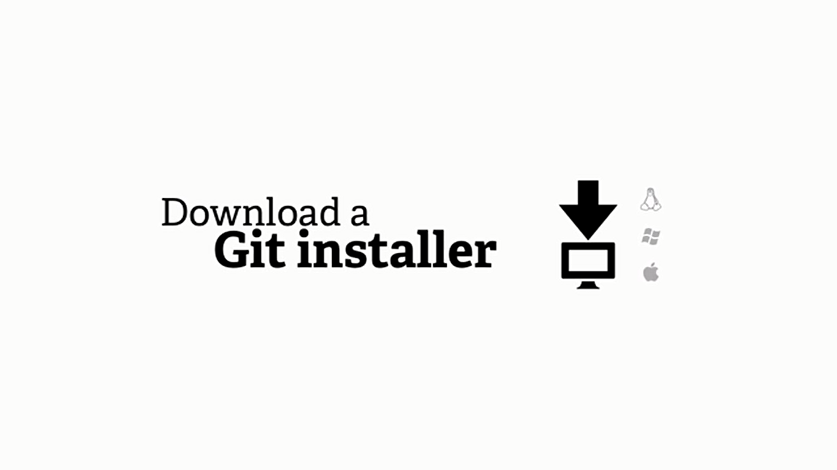
Where to get it?
GIT comes with an installer and it is available for every platform.
You can download it from :
http://git-scm.com/downloads After Downloading for appropriate operating system, Just Follow the instructions and press “next”. (Until and unless you know something about Git already)

Slide 18
Configuring GIT

Slide 19
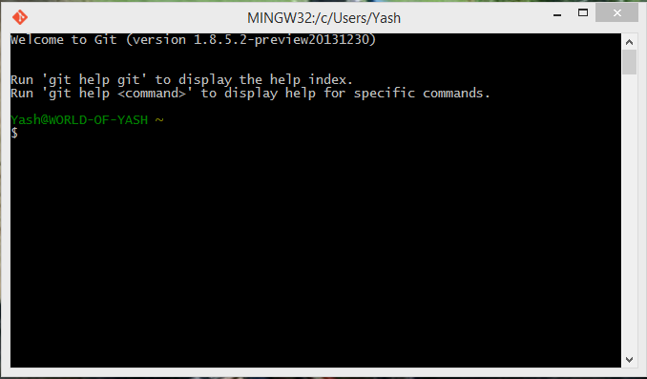
1) Open GIT BASH

Slide 20
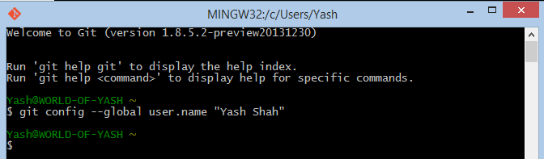
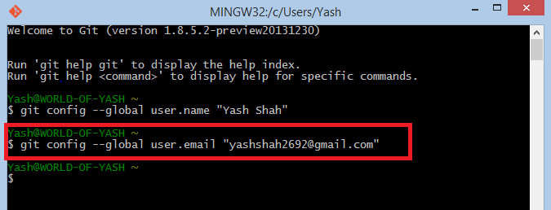
2) Set Username 3) Set Email
2.
3.

Slide 21
Creating “Repository”

Slide 22
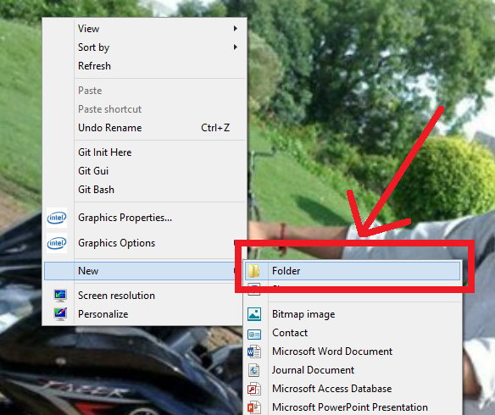
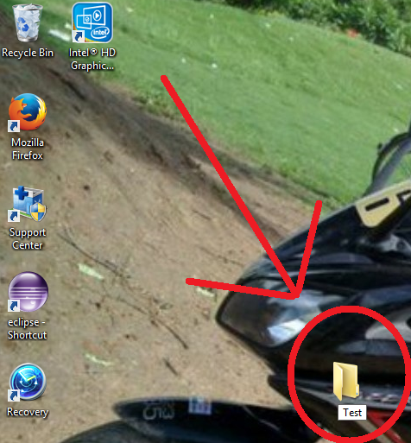
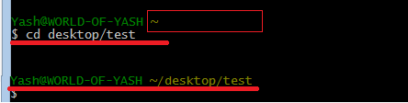
Create a folder.
Change directory to that folder.
1.
As you can see, I have created a new folder - TEST on desktop.
So I’ll change my directory to desktop/test.
2.

Slide 23

Initiate Git repository.

